Slide 1
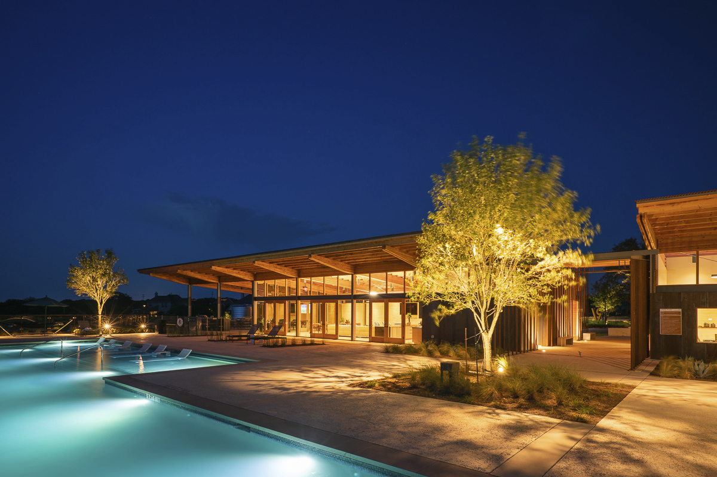
Welcome to the
Second Annual Meeting

Slide 2
Special Guests Introductions
Dr. Robert E. Moon Presentation
Agenda
Welcome!
Call to Order
Meeting Notice and Quorum
Introductions
Approval of 2018 Minutes
Management Report
Who does what?
ACC Improvements
2020 Budget
Lifestyle Report
Review
Looking Ahead
Developer Report
2019 Recap
2020 Look Ahead
Special Guests Introductions
Dr. Robert E. Moon Presentation
Georgetown Police Department
Raffle!
Q&A
Adjourn
Live
Smart

Slide 3
Introductions
Management Team
Wendy Mueller, PCAM
GENERAL MANAGER HOA
Peggy Bessellieu
LIFESTYLE DIRECTOR
Tanya Mendenhall
VICE PRESIDENT
Teffani Davis
DIRECTOR
Duke Kerrigan
AUSTIN GENERAL MANAGER
Tori Streff
MARKETING & COMMUNITY RELATIONS MANAGER
John Tatum
DEVLOPEMENT MANAGER
Live
Smart

Slide 4
Service Team
Board of Directors
Duke Kerrigan
Kim Cominsky
John Tatum
Daily HOA Oversight:
Manager – Wendy Mueller
More HOA Support:
Architectural – Tabitha Hardin
Accounting – Amanda Hughes
Resales – Cindy Ortiz
HOA
Service
Team
Community Maintenance Team:
Eric McFerrin
Contracted Service Providers
Live
Smart

Slide 5
Purpose and Benefit of the HOA
Protect and Enhance Property Values
CC&R Compliance
Architectural Review
Maintenance of Common Areas
The Den
Streetscapes and ROW’s
Parks, Greenbelts and Entry Features
Provide Programming and Lifestyle to Enhance Quality of Life and Promote a Sense of Community
Live
Smart

Slide 6
Who does what?
Who Is The Developer?
Plans the layout and design elements
Installs infrastructure
Forms the Association
Works with legal counsel to create governing rules and guidelines
Deficit funds the association
Who Is On The Board And What Is Their Role?
Representatives of the Development Team
Approval of budgets & contracts
Determines assessment rates
Establishes committees
Initially serves as the ACC
What Is The Management Company’s Role?
Provide information, training, and leadership on the Association’s operations to the Board and the community at large
Resident liaison
Accounts payable & receivable
Budget preparation for Board approval
Meeting facilitation
Coordination with vendors
CC&R enforcement
Stay informed of legislative changes and industry advances
Live
Smart

Slide 7
Wolf Ranch Governing Documents
The HOA is also responsible to ensure the association and its members are in compliance with the following:
Local, State and Federal Laws
Declaration of Covenants, Conditions & Restrictions (CC&R’s)
Benefitted Area Covenants
Architectural Guidelines
Bylaws
Rules & Regulations
Live
Smart

Slide 8
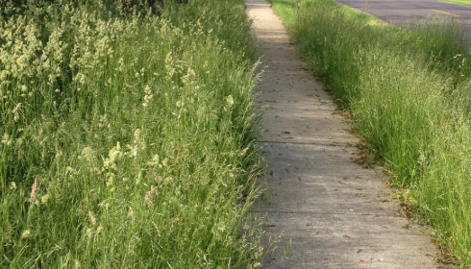
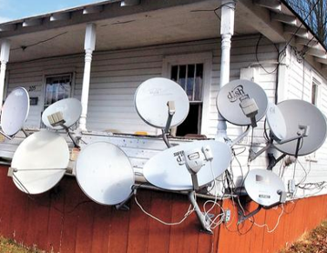
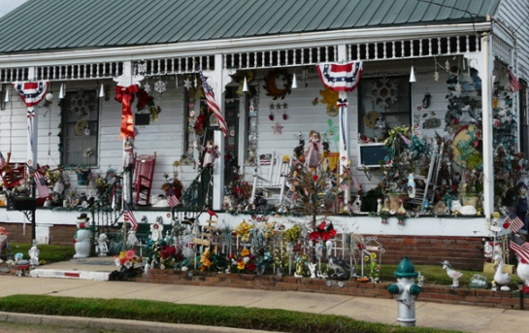
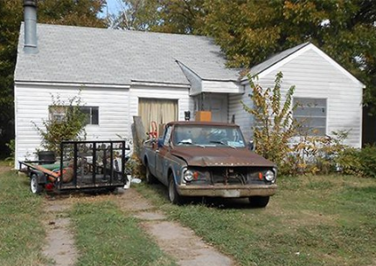
Community Rules
Compliance
keep this from happening…
Live
Smart

Slide 9
Architectural Requirements
Architectural Improvements -
Any change, addition, alteration, or modification of any kind to the exterior of the home or on the lot requires the submittal of an ACC Application and approval in writing before installation. ACC applications are available at www.wolfranchhoa.com
Live
Smart

Slide 10
Wolf Ranch Architectural Statistics:
Architectural Modification Requests:
2019 - 60
2018 - 49
2017 - 6
New Home Reviews:
2019 - 124
2018 - 148
2017 - 6
Live
Smart

Slide 11
Accomplishments:
Completed Homes – 282
Under Construction – 38
Playground Installation
Phase 1 Mailbox Lighting
Reseal of Den Exterior
Turf Transition on Legacy
Landscape Upgrades
Reserve Study
Pool Repairs
Live
Smart

Slide 12
Budget Comparison 2019 - 2020
Live
Smart

Slide 13
2020 Budget - Income:
Live
Smart

Slide 14
2020 Budget Expense:
Live
Smart

Slide 15
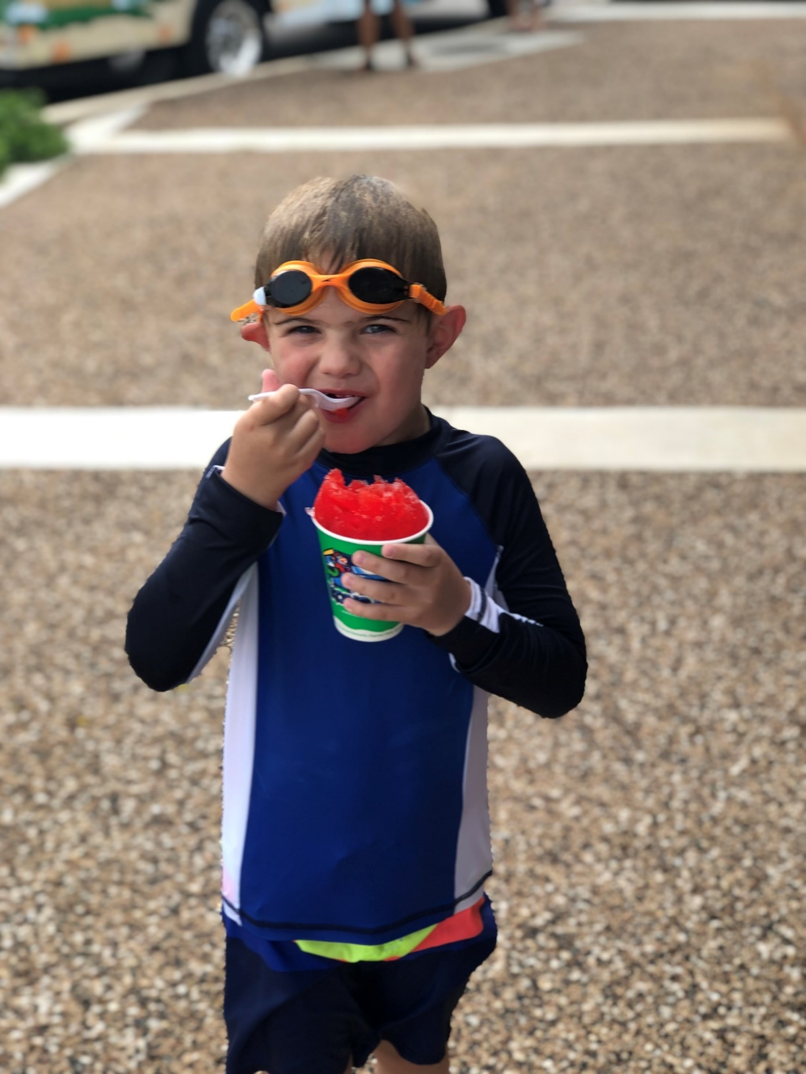
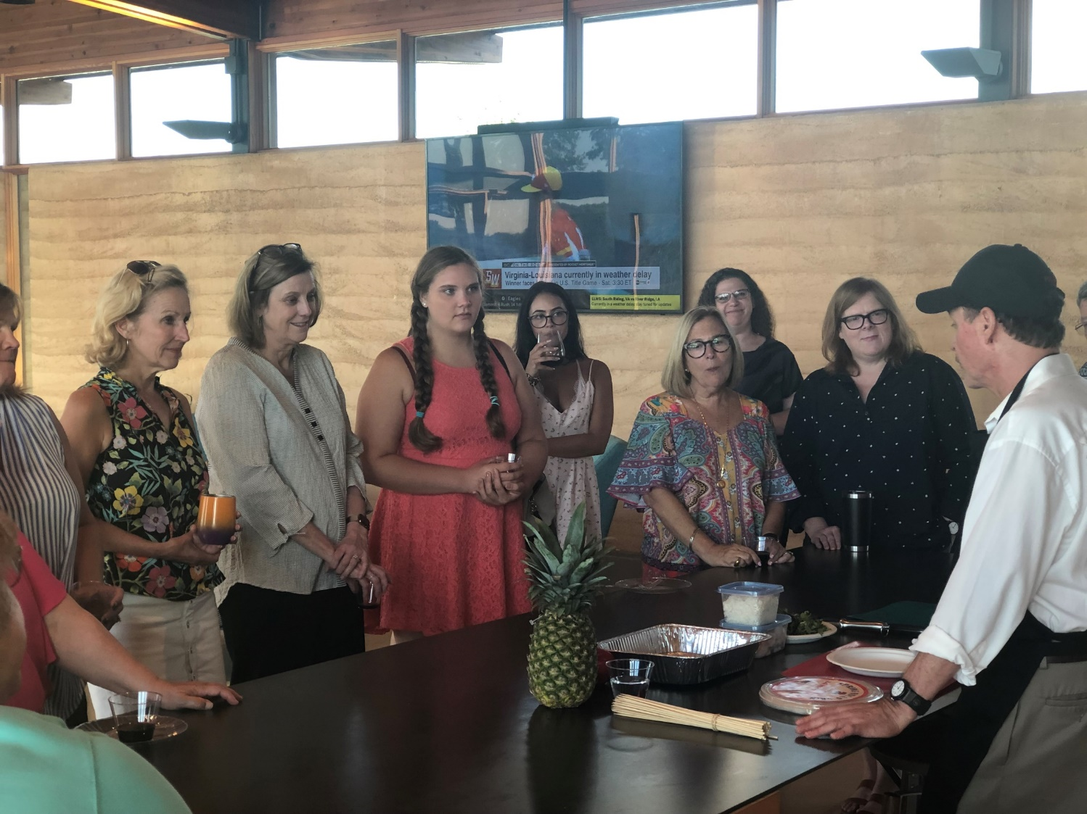
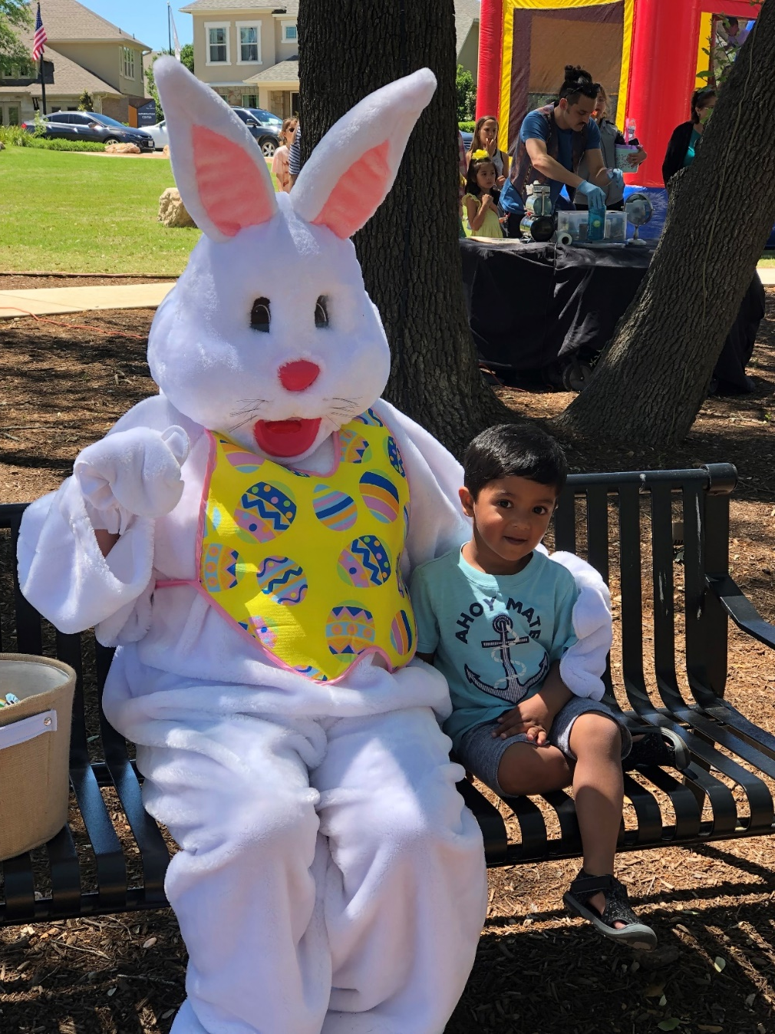
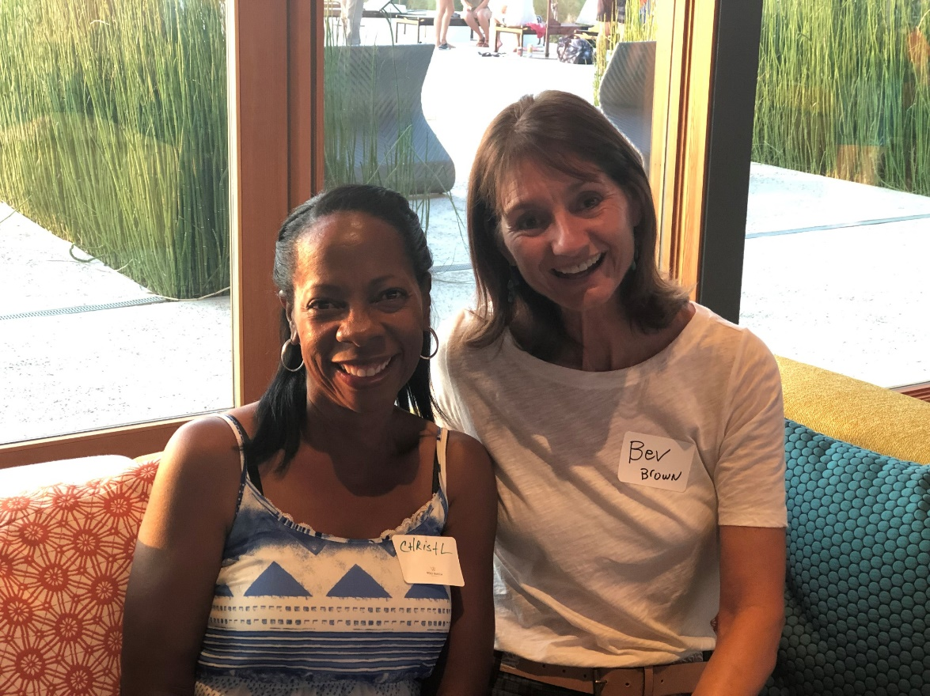
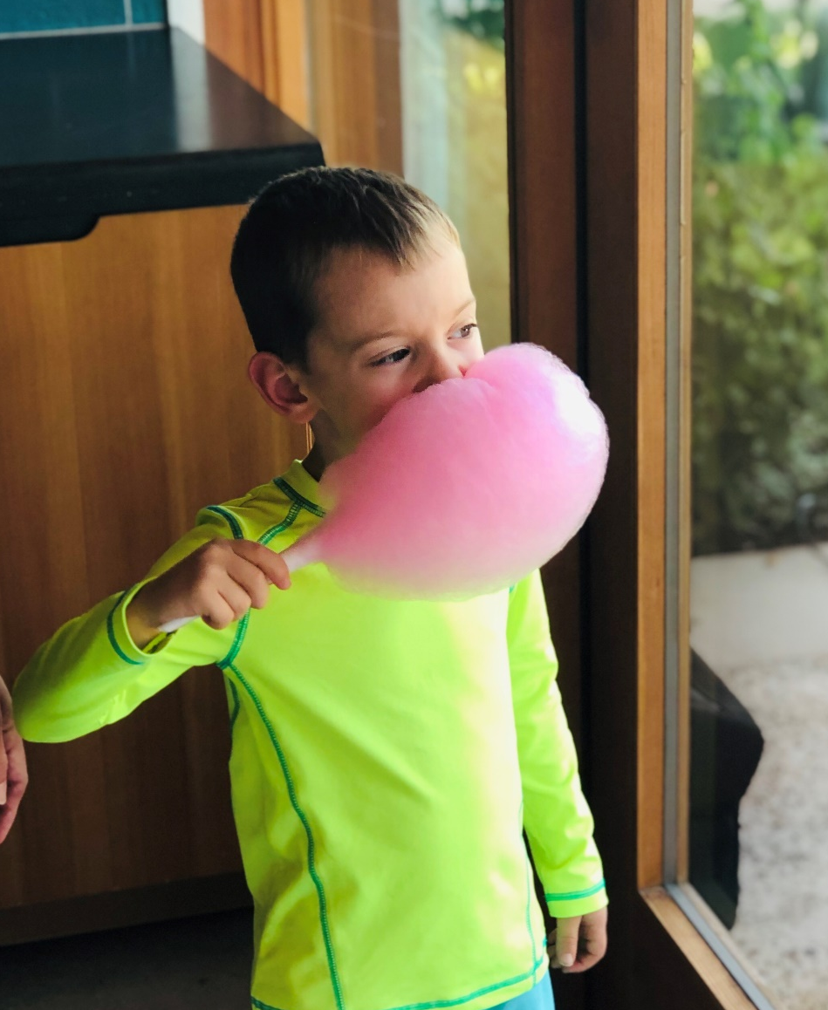
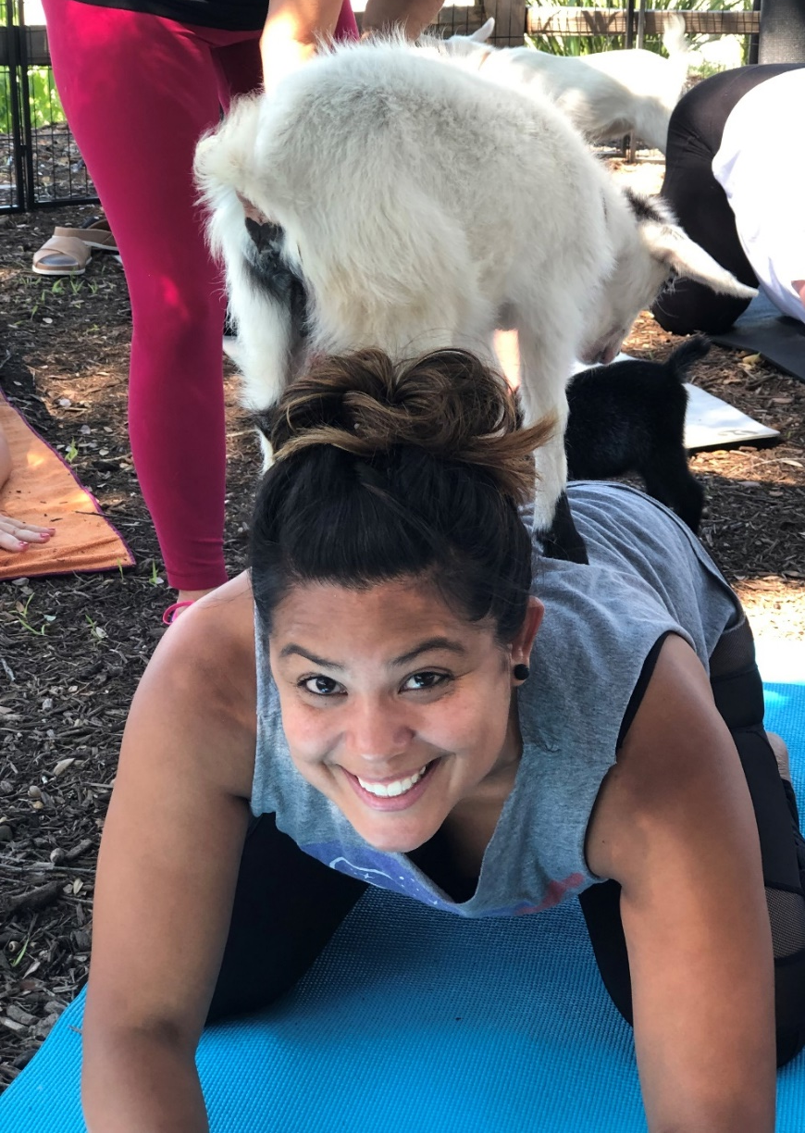
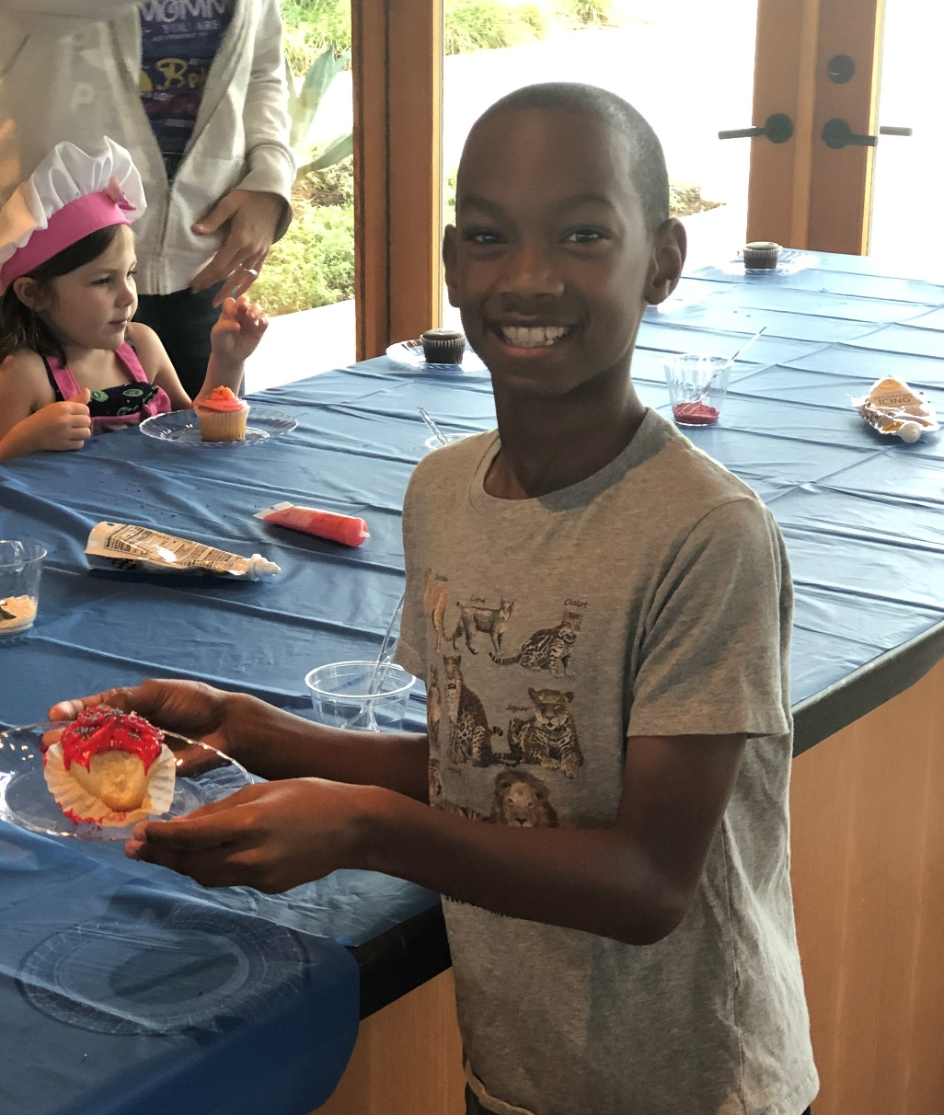
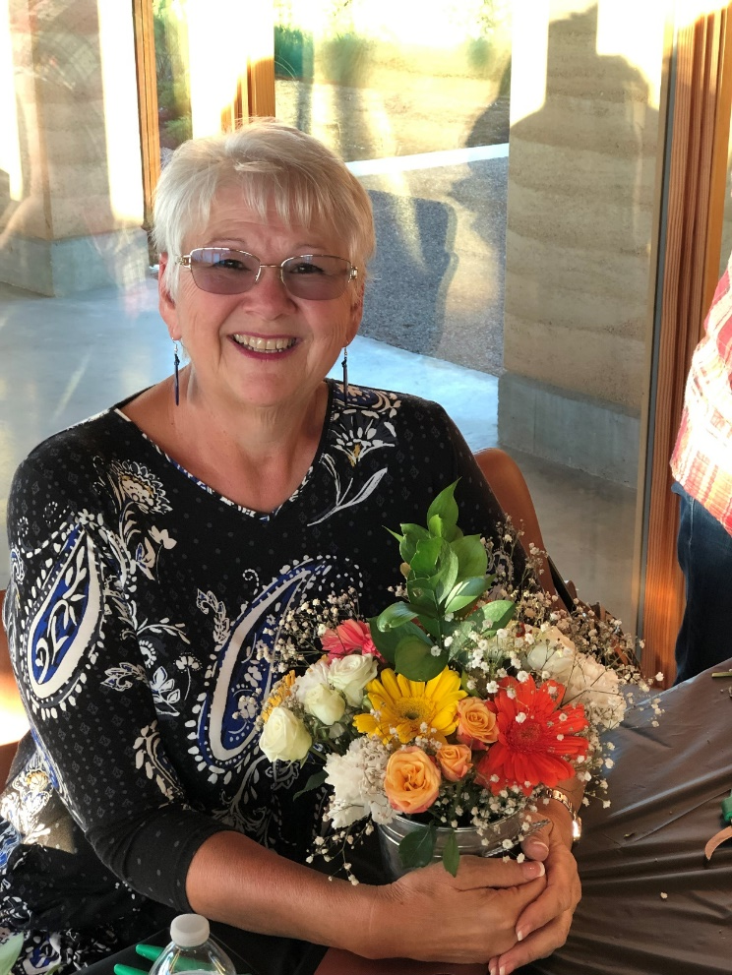
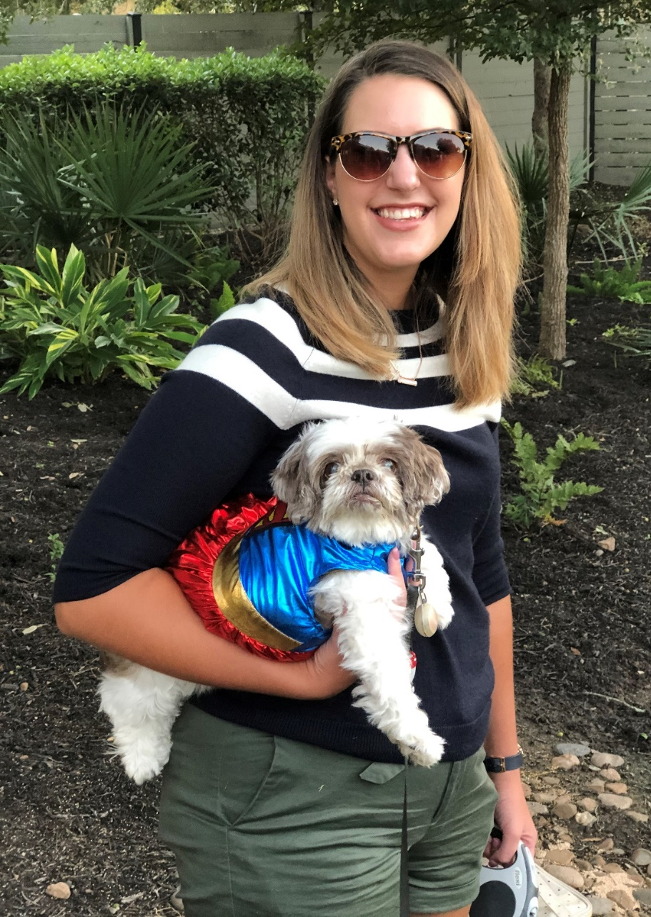
Lifestyle at Wolf Ranch
Live
Smart

Slide 16
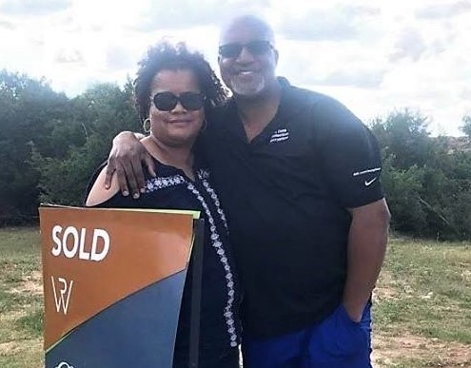
What is not to love about Wolf Ranch! The neighbors, the Den and all of the social activities have exceeded our expectations.
When my wife and I thought about buying a new home last year, we looked at a lot of communities, but when we found Wolf Ranch, we were swayed. What sealed the deal was the lot that was available on Canyon View Road - the future view was going to be spectacular, and the flexibility we had to customize our home nailed it. Nearly a year later and we can still hardly believe we live here! Great neighbors, excellent amenities, and the view have made us decide this is our forever home! -Brian Scott
"Living in Wolf Ranch has been such an exceptional experience. From the moment we arrived in the neighborhood, our family felt the warmth and open arms from every neighbor. Our exceptional HOA coordinates activities that create a multitude of opportunities for community closeness. Neighbors quickly feel like family and genuinely care for one another. Wolf Ranch is a special place to live and we feel blessed to be a part of such a unique community!"
-Tania E
Wolf Ranch is the best community. I have lived in many places, and this one is my favorite!
LIFESTYLE:
#TestimonialTuesdays
Wolf Ranch is an amazing neighborhood dedicated to lifestyle, sense of community, family and making friends.
Live
Smart

Slide 17
LIFESTYLE
LOOKING FORWARD TO 2020……
Mixology Class
Barre Class and Social
Law Enforcement Appreciation
Spring Fling and Egg Hunt
Cinco de Mayo
Cooking Classes
July 4th Celebration
Fall Festival
Friendsgiving
Brunch with Santa
Live
Smart

Slide 18
About Hillwood
One of the country’s leading independent real estate development firms
Founded by Ross Perot, Jr. in 1988
Headquartered in Dallas, TX
Core competencies
Industrial/Logistics
Mixed-Use/Retail
Multifamily
Residential Communities

Slide 19
Developer Update:
2019 – Recap
New Builder Activity – Highland Homes & Lennar
New Home Sale Activity – 110
Average Home Cost - $422,000 (last 12 months)
Average Home Size – 2,600 Square Feet
Lots Delivered – 271
Live
Smart

Slide 20
Developer Update:
2020 – Look Ahead
Lots Under Development – 287
Lots in Design - 300
Future Lots – 1,300 (Total at Build Out ~2,600)
Wolf Ranch – Hilltop and South Fork
Wolf Ranch Elementary
Phase 3, 4 and 6
Wolf Ranch Vision (South of Hwy 29)
Live
Smart

Slide 21
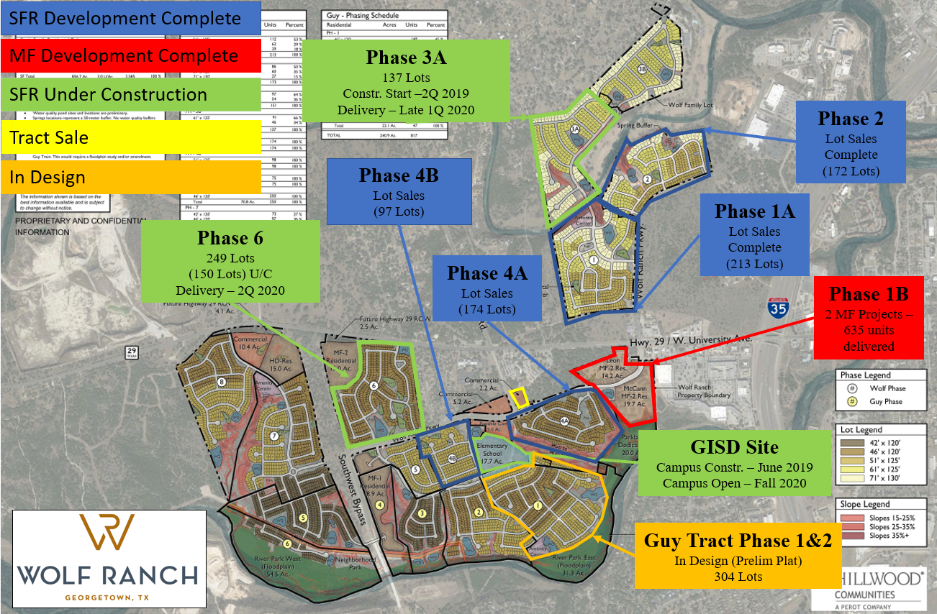
Developer Update:
Live
Smart

Slide 22
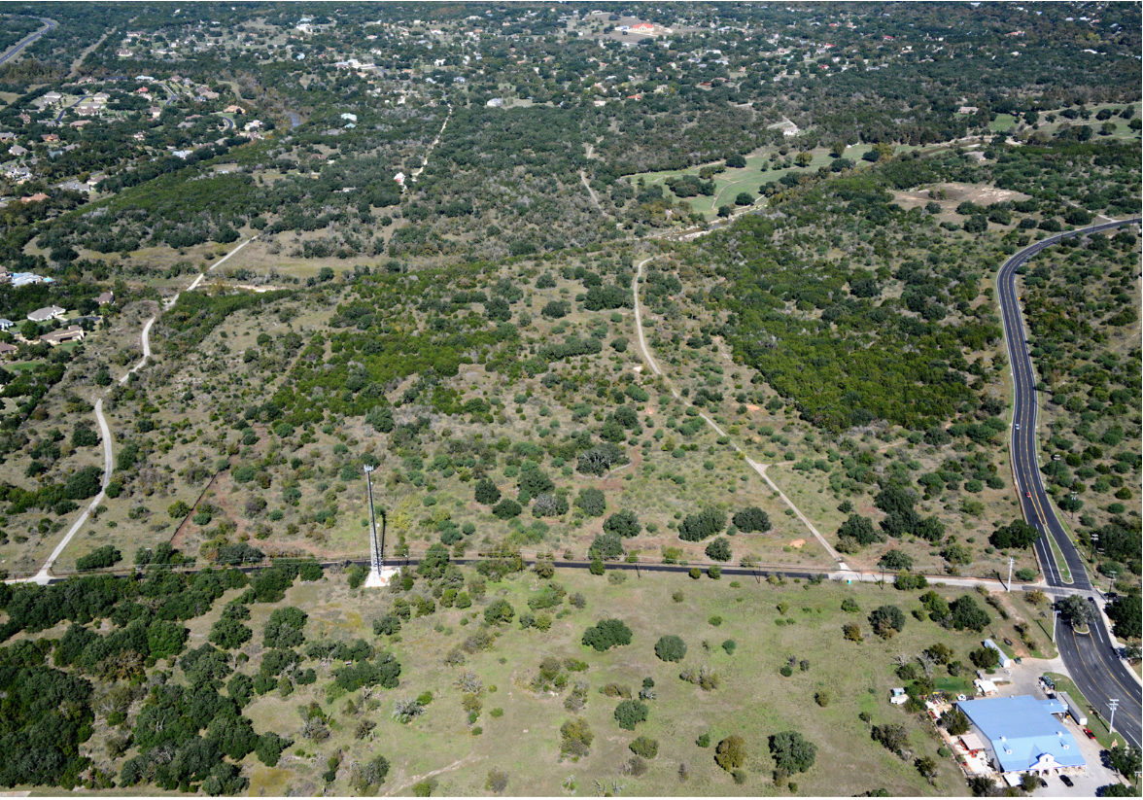
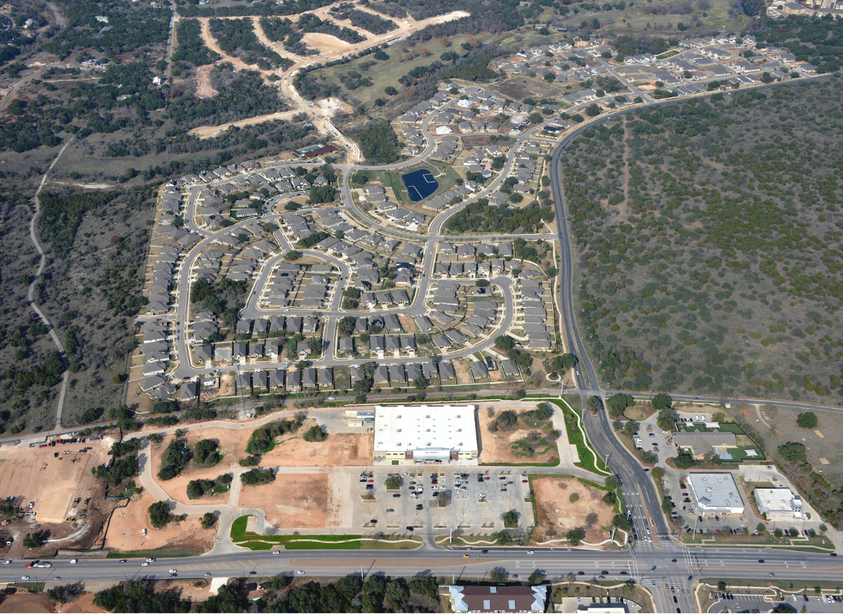
Wolf Ranch Growth:
WOLF RANCH (NORTH OF HWY 29 – NOV. 2015)
WOLF RANCH (NORTH OF HWY 29 – JAN. 2020)
Live
Smart

Slide 23
Special Guests:
Dr. Robert E. Moon, Horticultural Consultant
Wayne Nero, Georgetown Chief of Police
Delta Jolly, City of Georgetown Community Engagement
Lt. Bert Witcher, City of Georgetown Police Department
Nate Fontaine, HomePro Sales Manager
Ben Strickland, Brightview Account Manager
Live
Smart

Slide 24
Special Guest Speaker:
City or Georgetown Assistant Chief of Police
Cory Tchida
Live
Smart

Slide 25
Special Guest Speaker:
Dr. Robert E. Moon
Horticultural Consultant
Additional resources by Dr. Moon are available at wolfranchhoa.com
Live
Smart

Slide 26
Raffle Prizes
Thank you to our generous sponsors and business partners for the annual meeting raffle prizes!!
Live
Smart

