Slide 1
WOLF RANCH HOA Meeting April 9, 2021
Spring
Landscaping

Slide 2
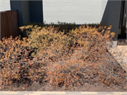
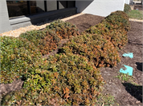
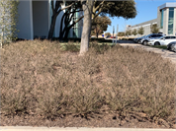
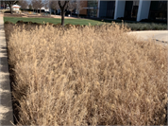
The Elephant in Your Yard– Freeze Damage

Slide 3
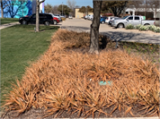
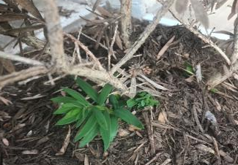
BE PATIENT – Do not cut back too quickly
Maintain a good agronomic program
Trim back to living tissue or new buds
Avoid any new stress on plants

Slide 4
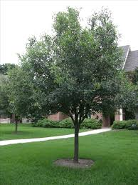
TREE FERTILIZATION
Slow Release
Provide more uniform growth
Less likely to burn
Lasts longer in soil
Less polluting

Slide 5
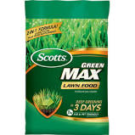
What do the 3 numbers on the bag mean?
16-4-8
27-0-2 Scott’s Green Max
32-0-4
N = Nitrogen
P = Phosphorous
K = Potassium
When to apply:
April, May and September

Slide 6
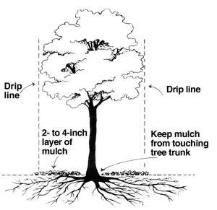
Where to apply FERTILIZER
Apply ½ pound per inch trunk diameter spread evenly from trunk out to dripline of tree
Water tree thoroughly after applying fertilizer
Mulch tree ring after fertilization to conserve moisture and better utilization of fertilizer
Apply a double ground brown or black mulch around the tree
Tree rings should be no larger than 4 feet in diameter

Slide 7
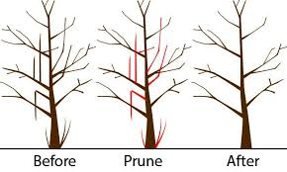
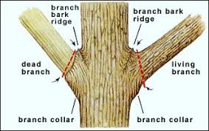
Correct Pruning of Trees
Remove:
broken branches
Sucker growth
Root sprouts
Crossover branches
For quicker healing, final cut is at branch bark ridge

Slide 8
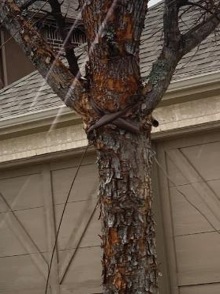
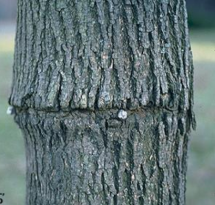
BAD NEWS FOR TREES: Monitor tree staking

Slide 9
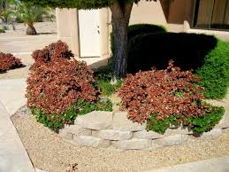
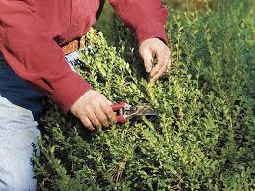
Correct Pruning of Shrubs:
Pick prune back to new buds or green branches

Slide 10
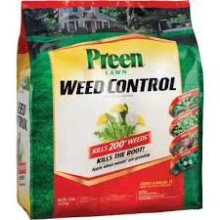
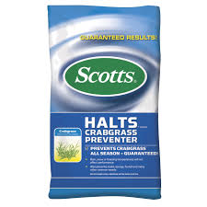
PRE-EMERGENT WEED CONTROL
Why use a pre-emergent
When to apply a pre-emergent - March
Kind of pre-emergent to apply

Slide 11
WATERING
The irrigation system will be switched to OFF position October through May and the following run times in those months will only apply during periods of drought.
FEBRUARY – Set to run 1 time every 2 weeks
MARCH, APRIL, MAY – Set to run 1 time every 7 to 10 days
JUNE– Set to run 1 to 2 times per week
JULY – Set to run 2 times per week
AUGUST– Set to run 1 to 2 times per week
SEPTEMBER – Set to run 1 time per week
OCTOBER – Set to run 1 time every 7 to 10 days
NOVEMBER – Set to run 1 time every 2 weeks
DECEMBER AND JANUARY – Turn Controller OFF

Slide 12
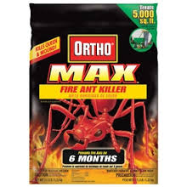
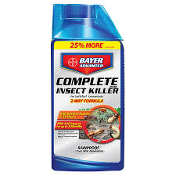
FIRE ANT CONTROL – TEXAS TWO STEP
STEP ONE – Apply a bait
STEP TWO – Mound Treatment

Slide 13
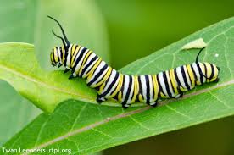
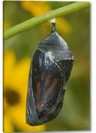
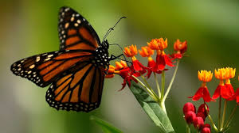
How to Attract Monarch Butterflies – Plant Milkweed and they will come!

